Slide 1
Washington State Influenza Impact Research Project
Produced By: Gerard Jaena, Halina Kuczynski, Jackson Milner, Kyle Risso
(P6-T2)

Slide 2
Project Goals & Questions
Are there any patterns to when outbreaks occur?
Time-Series
Where are outbreaks most impactful?
Geospatial Time-Series Heatmap
Can preventative measures actively reduce the impact of outbreaks?
Binomial Logistic Regression
Who is most at risk from outbreaks?
Hierarchical Clustering Dendrogram

Slide 3
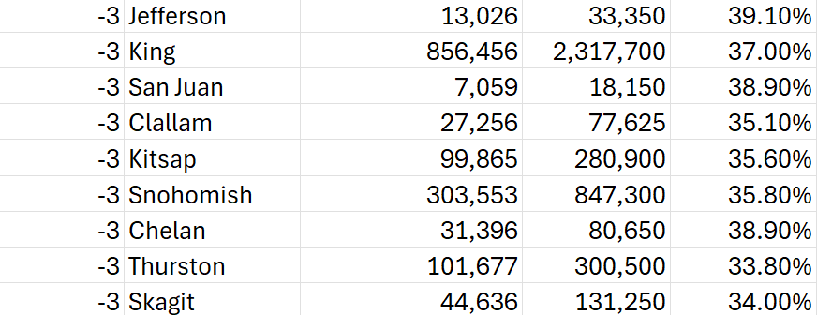
Project Data – Vaccinations Dataset
[Season]: year associated with each entry from the current year
[County]: the county for each entry
[People Vaccinated]: total vaccinated for each [County] by [Season]
[Population]: the population for each [County] by [Season]
[Coverage %]: [Population]/[People Vaccinated] as a percent

Slide 4
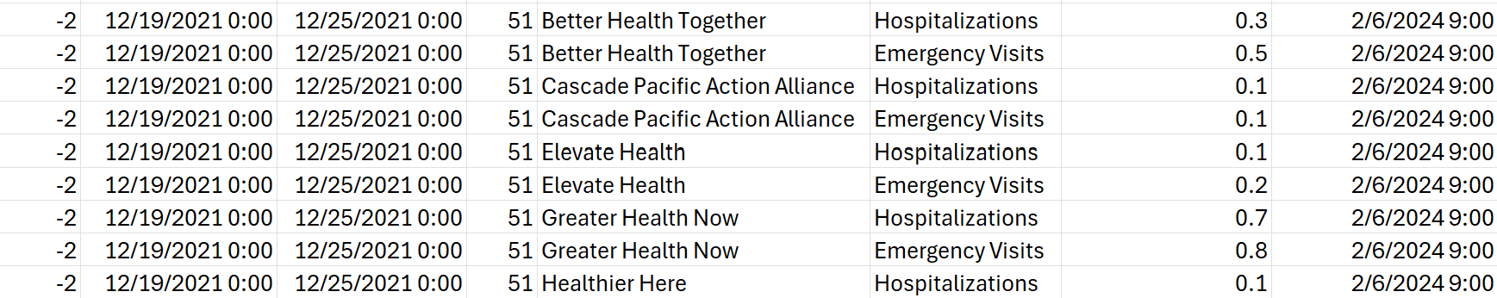
Project Data – Influenza (RHINO) Dataset (Total)
[Week End]: closing date associated with the entry
[Location]: hospital location associated with the entry
[1-Week Percent Flu]: percentage of flu hospitalizations by [Location] at [Week End]

Slide 5
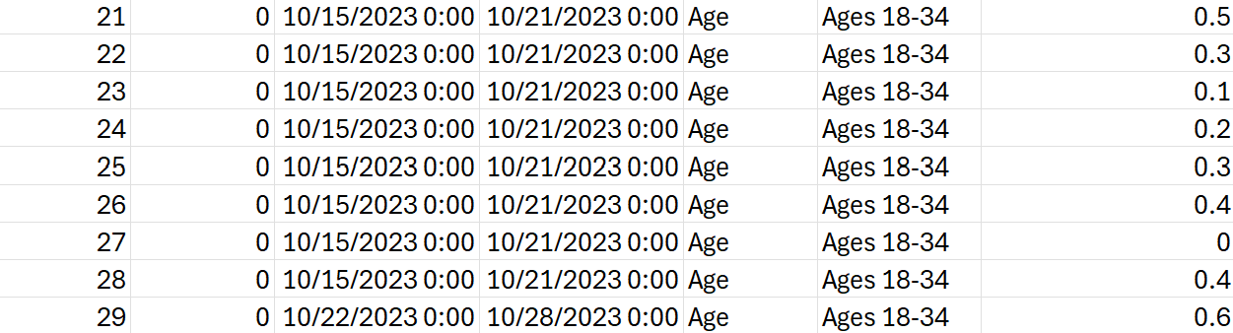
Project Data – Influenza Dataset (Demographics)
[Class]: the demographic class being measured (age, race, sex)
[Demographic]: the demographic being measuring within [Class]
[1-Week Percent Flu]: percentage of flu hospitalizations statewide by [Demographic] at [Week End]

Slide 6
Data Cleaning & Processing - Initial
Join Vaccinations & Influenza Tables
Mapped Influenza[Location] to Vaccinations[County]
Standardized data types
Merged Tables by Vaccinations[Season] and Influenza[Week End] year
Fill Null Data Values
Used EMAs (exponential moving averages) to complete data
obtained 122 consecutive weeks of entries per county + statewide

Slide 7
Data Cleaning & Processing - Models
Regression Model
Removed Incomplete Years (2021 & 2024)
Aggregated data by season and location, calculated average flu percentages and vaccination coverage
Created [High Incidence] Column for Data Exceeding 75th Percentile of Total % of Flu Hospitalizations
Time-Series & Clustering Models
Extracted Data for Total Hospitalizations
Used Data to Convert [1-Week Percent Flu] to Numeric Value
Scaled Value using [Population] Data to Produce [Infection Count]
Calculated Vaccine Efficacy Rates and Used to Weight [Infections Count]

Slide 8
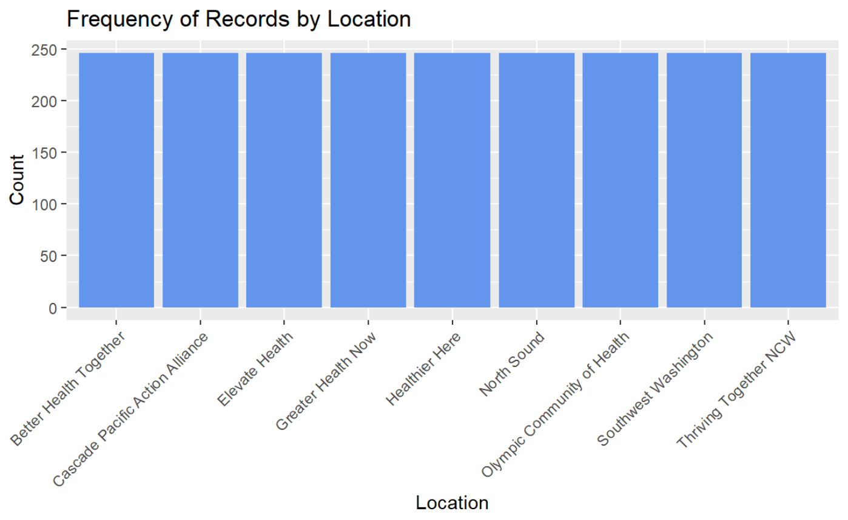
Exploratory Data Analysis – Data Interest
Initial Efforts Revealed that the Data was Perfectly Balanced and [1-Week Percent Flu] would be the Only Transactable or Deliverable Data

Slide 9
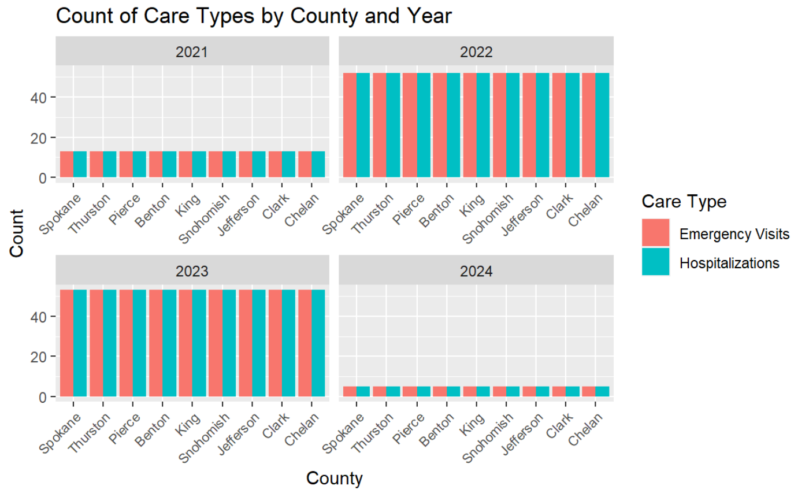
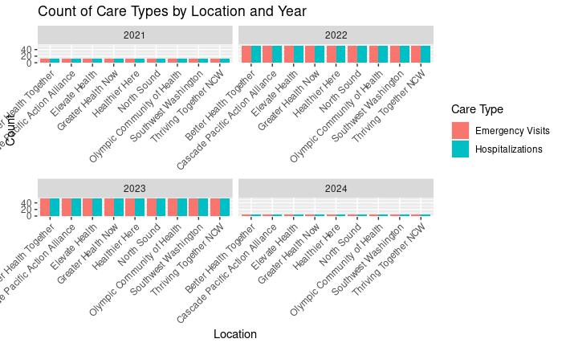
Exploratory Data Analysis – Time Range Adjustment
Incomplete Data from 2021 & 2024 Skews Regression Analysis. The Project Omitted this Data for any Regression Modeling to Ensure Accuracy.

Slide 10
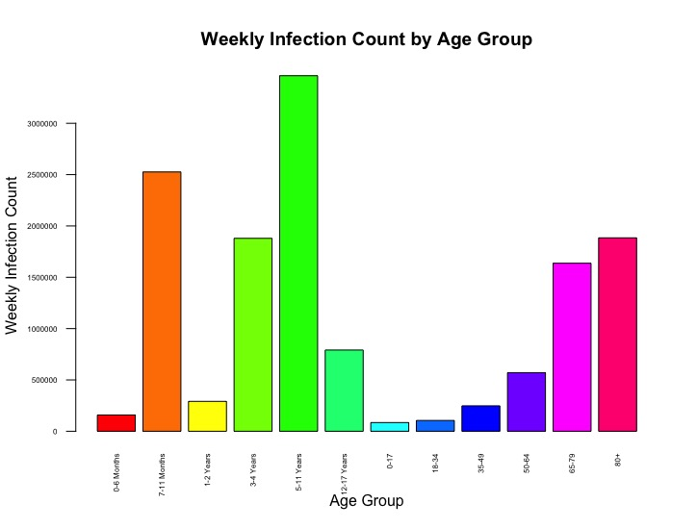
Exploratory Data Analysis – Demographic Focus
The Age Class is the only Demographic with Enough Entries for Modeling, so Clustering was Only Performed on the Age Demographic

Slide 11
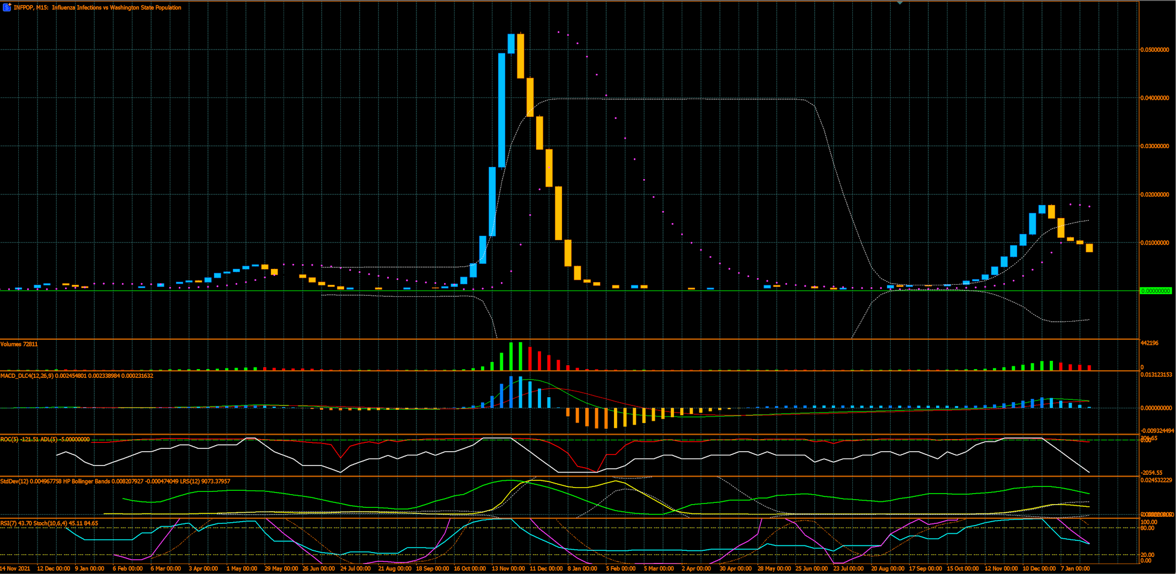
Answer #1 - There are Patterns to When Outbreaks Occur
Pattern #1: “Spring Fever”
occurs in May annually
long spread with few infections
Pattern #2: “Flu Season”
occurs in December annually
burns hot and fast

Slide 12
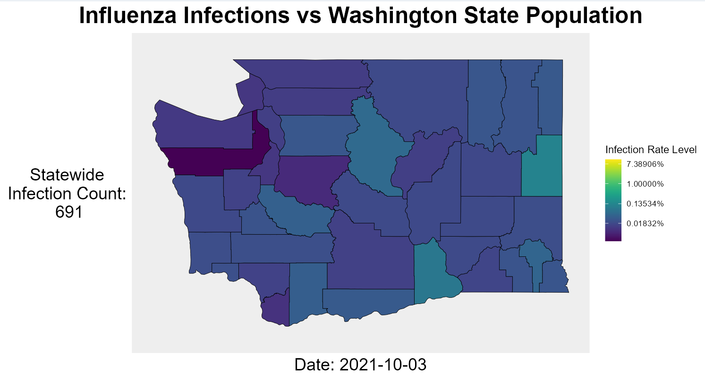
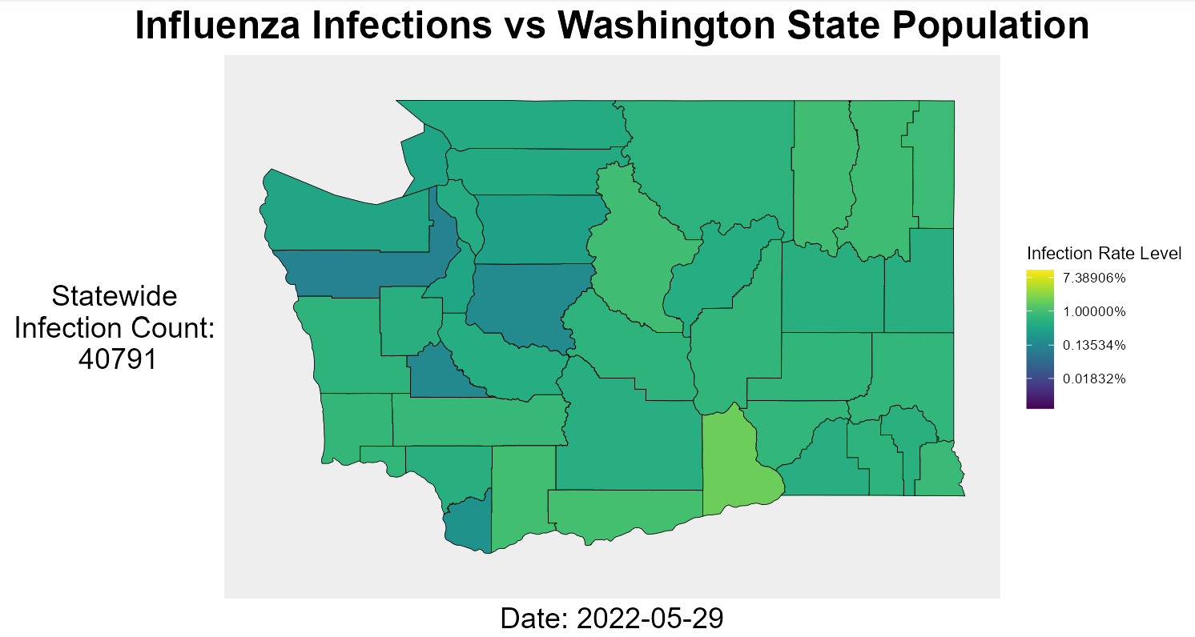
Answer #2 – Influenza Does Not Have Any Notable Hotspots in Washington State
Outbreaks tend to affect all counties similarly during high and resting periods of infection
Further ANOVA testing confirmed that location is not a significant factor in predicting outbreaks

Slide 13
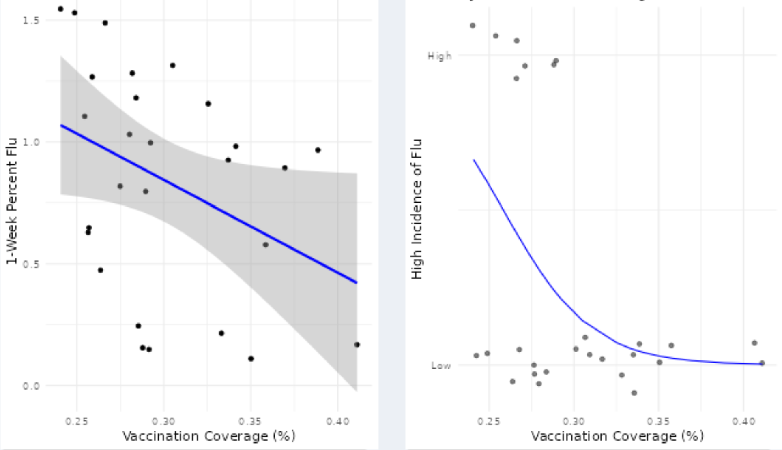
Answer #3 - Higher Vaccination Coverage can Help Control the Transmission of Influenza
Regression modeling indicated a negative relationship between vaccination rates and flu incidence

Slide 14
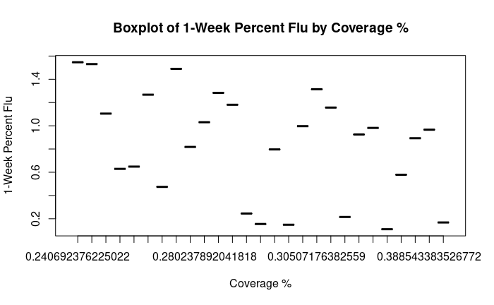
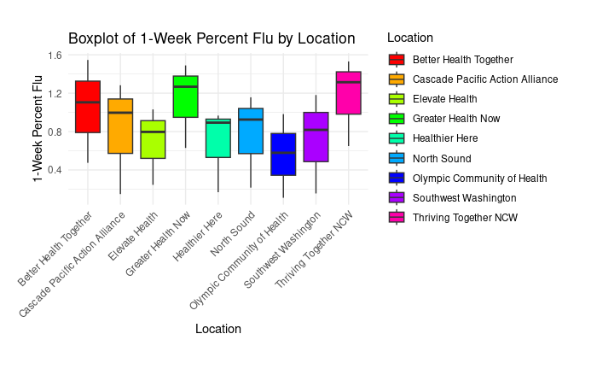
Answer #3
Location does not have a significant impact on flu incidences
There is a slight significant impact on the flu incidence rate as coverage percent increases

Slide 15
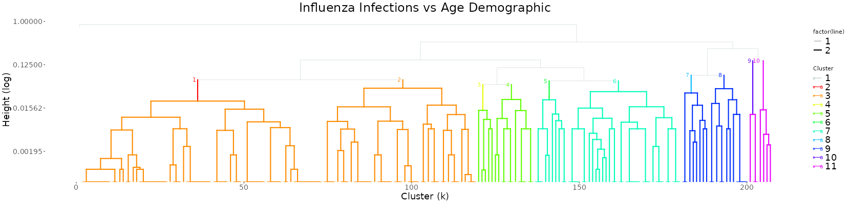
Answer #3 - Age is a Notable Factor in Influenza Targeting
The first 2 clusters show a high variance of age range; age is not likely a factor in these patterns
The last 2 clusters show a very tight cluster; age is likely almost exclusively the pattern of this cluster
The remaining clusters show a medium-variance; age is a probable factor in these infection patterns, but other factors are also present

Slide 16
Sources
Literature Review
Placeholder
Vaccinations Dataset
Placeholder
Influenza (RHINO) Dataset
Placeholder
Admissions PDF/Chart
Placeholder

